Slide 1



Mental health during COVID-19: What is the role of technologies? Australian Public Health Conference 2020 Oct 20
Ms Huong Ly Tong MRes BHealth
Research Affiliate, Westmead Applied Research Centre
PhD Researcher, Australian Institute of Health Innovation
Twitter: @lytong22
Email: huong.tong@sydney.edu.au
Notes:
Acknowledgement of country: I’d like to begin by acknowledging the Traditional Owners of the land on which we meet today.
I would also like to pay my respects to Elders past and present.
Ly – PhD in Health Technology. How to leverage innovative technologies to promote healthy behaviour.
It is my pleasure today to share with you about one of our projects, which looks at the impact of COVID-19 on the mental health of young adults (particularly university students) and discuss how technologies can help.

Slide 2
Outline
Background (Why we did the study)
Methods (What we did)
Results & Discussion (What we found)
Conclusion (Why you should care)
Notes:
Here’s an outline of the presentation, so you can be orientated throughout.

Slide 3
Outline
Background
Methods
Results & Discussion
Conclusion
Notes:
I’d like to start with the why – why we did the study

Slide 4

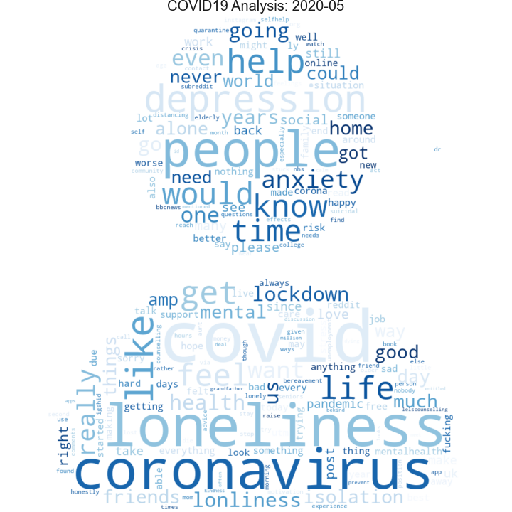
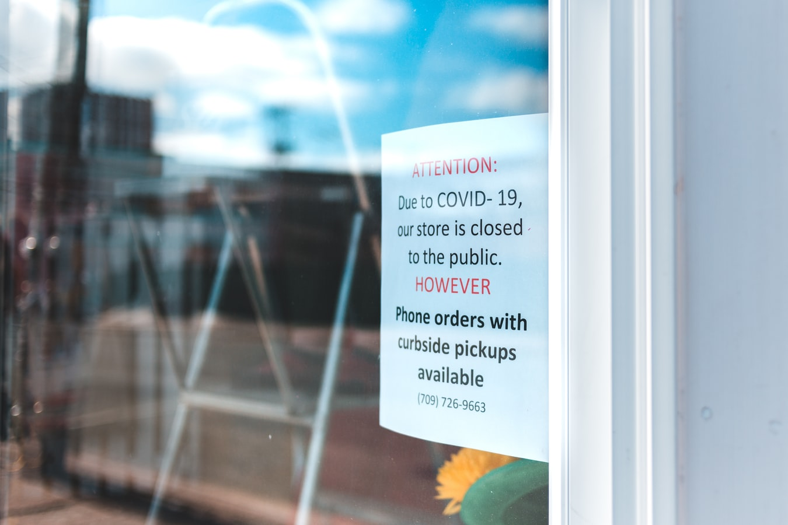
Background
Impact of covid-19 on university students’ mental health
https://medium.com/omdena/the-mental-health-impacts-of-a-depressed-society-c71c753e0197
Notes:
Some examples of COVID-19 on mental health for young adults:
COVID and subsequent public health measures have drastically impacted our lifestyles. Australia specifically had declared a health emergency and implemented strict public health and social measures which involves leaving the house for the essentials, keeping physical distancing, closure of many services and businesses.
Restriction on social movement, uncertainty about the future, job losses can have negative impact on health, including isolation, loneliness and anxiety.
Young adults face a particular set of challenges: a lot might be at university/in casual positions. COVID brings about a lot of feelings regarding job security, financial and study stress.

Slide 5
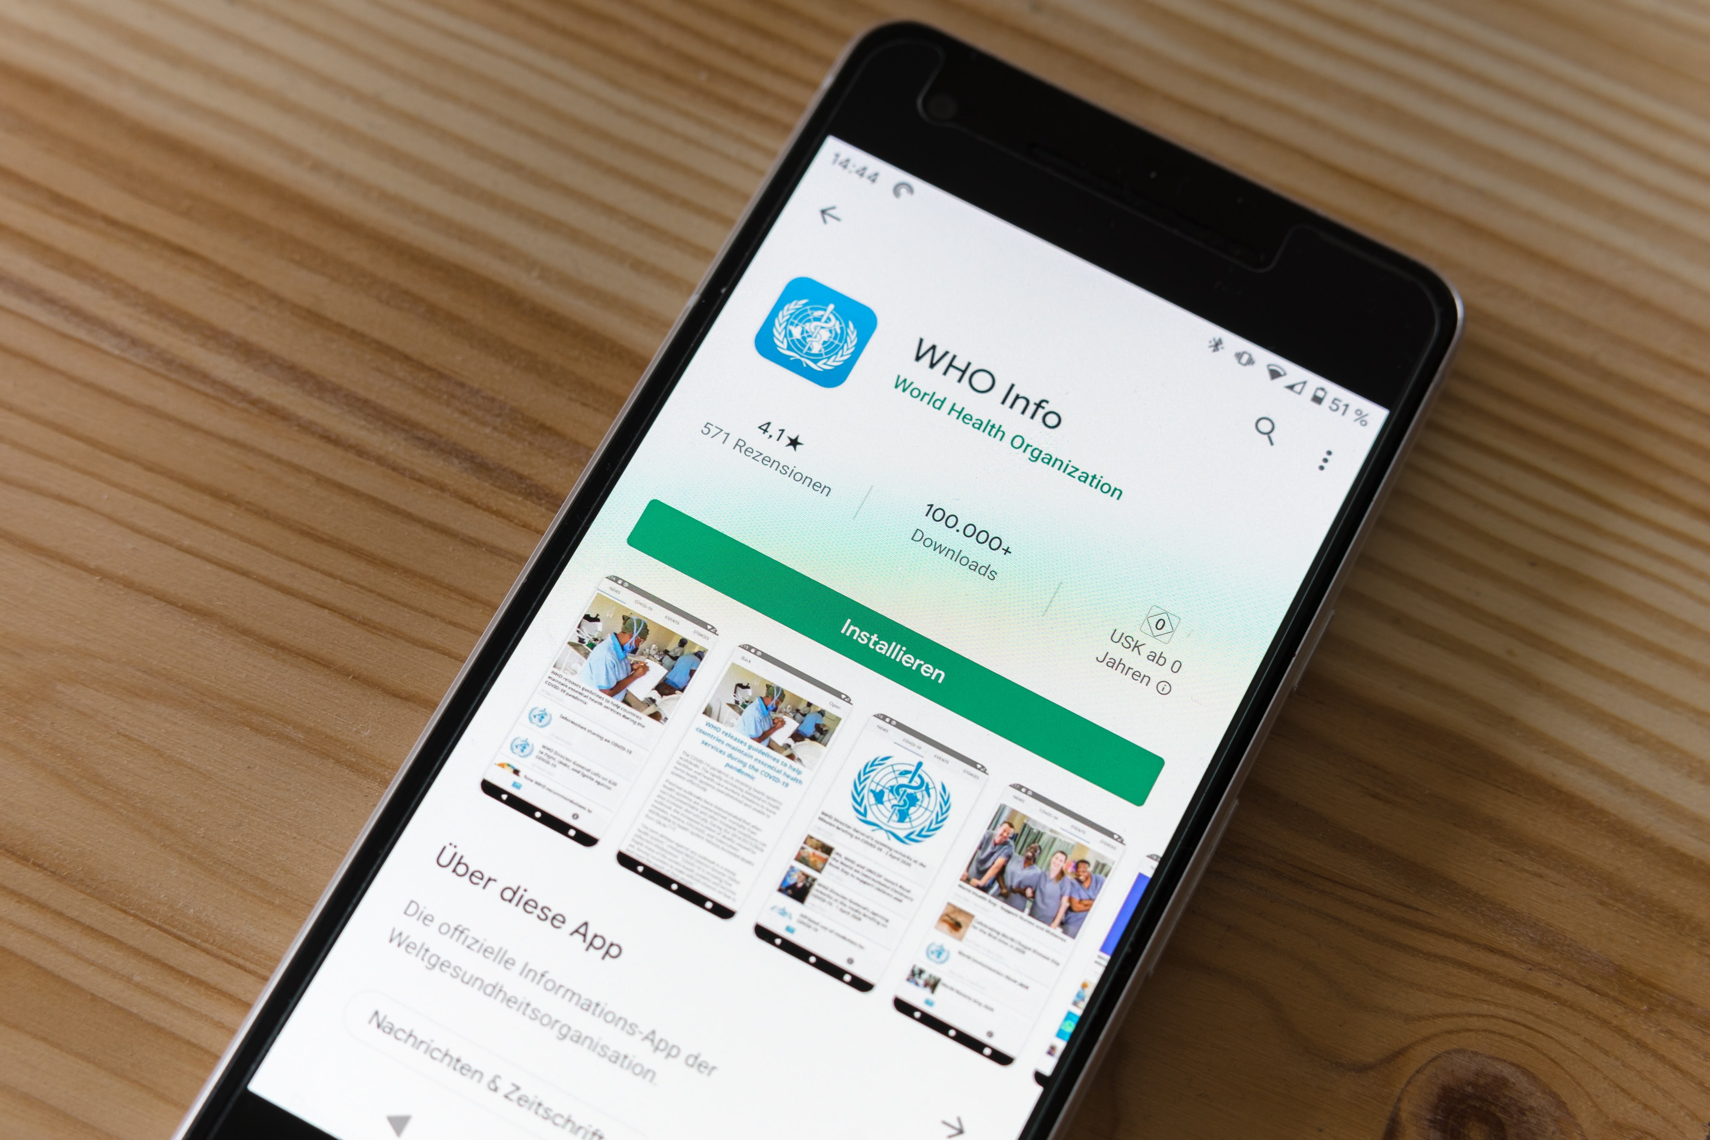
Background
Technologies: part of the solution?
Support physical distancing
Alleviate the strain on healthcare systems
Young adults = more tech-savvy?
Notes:
How technologies can help with mental health for young adults
In all of these uncertainties, technologies emerge as one potential solution, given the need for physical distancing and the strain on healthcare systems during the pandemic.
University students, young adults, tend to be more tech-savvy.
While a lot of COVID studies have documented the impact of mental health on general population, none has specifically looked at university students, nor explore the potential of technologies for this group. This brings me to the aims of our studies.

Slide 6

Background
Aims of our study
Understand the impact of COVID-19 on university students’ mental health
Explore how they used technologies to cope
Notes:
How technologies can help with mental health for young adults
In all of these uncertainties, technologies emerge as one potential solution, given the need for physical distancing and the strain on healthcare systems during the pandemic.
Aims of the study: 2 folds
=> What that means for us as public health practitioners

Slide 7
Outline
Background
Methods
Results & Discussion
Conclusion

Slide 8
Methods
data collection & analysis
Methods: Semi-structured Zoom interviews in May 2020
Sampling: University students in Sydney, aged 18 to 30 years
Analysis: Thematic analysis
@lytong22
Notes:
Methods: semi-structured interviews via Zoom.
Recruited university students aged 18 to 30 years
Location: Sydney
Stop data collection when data saturation was reached – more interviews do not give new ideas.
Data analysis: Audio-recorded, transcribed, and analysed using thematic analysis techniques.

Slide 9
Methods
Interview guide
General guide for the discussion
Development process: pilot test & revision
Main questions:
How has the COVID-19 outbreak affected your mental health?
How do you use technologies for your mental health?

Slide 10
Outline
Background
Methods
Results & Discussion
Conclusion
Notes:
Results:
Demographic: 16 women, age = 22 years.
Impact on mental health x 1 slide
Technology help x1 slide
What is lacking x1 slide => future actions

Slide 11



Results & Discussion
Sample characteristics
23 16 Mean = 22 years
Data saturation was reached.
Notes:
Demographic: 16 women, age = 22 years.

Slide 12
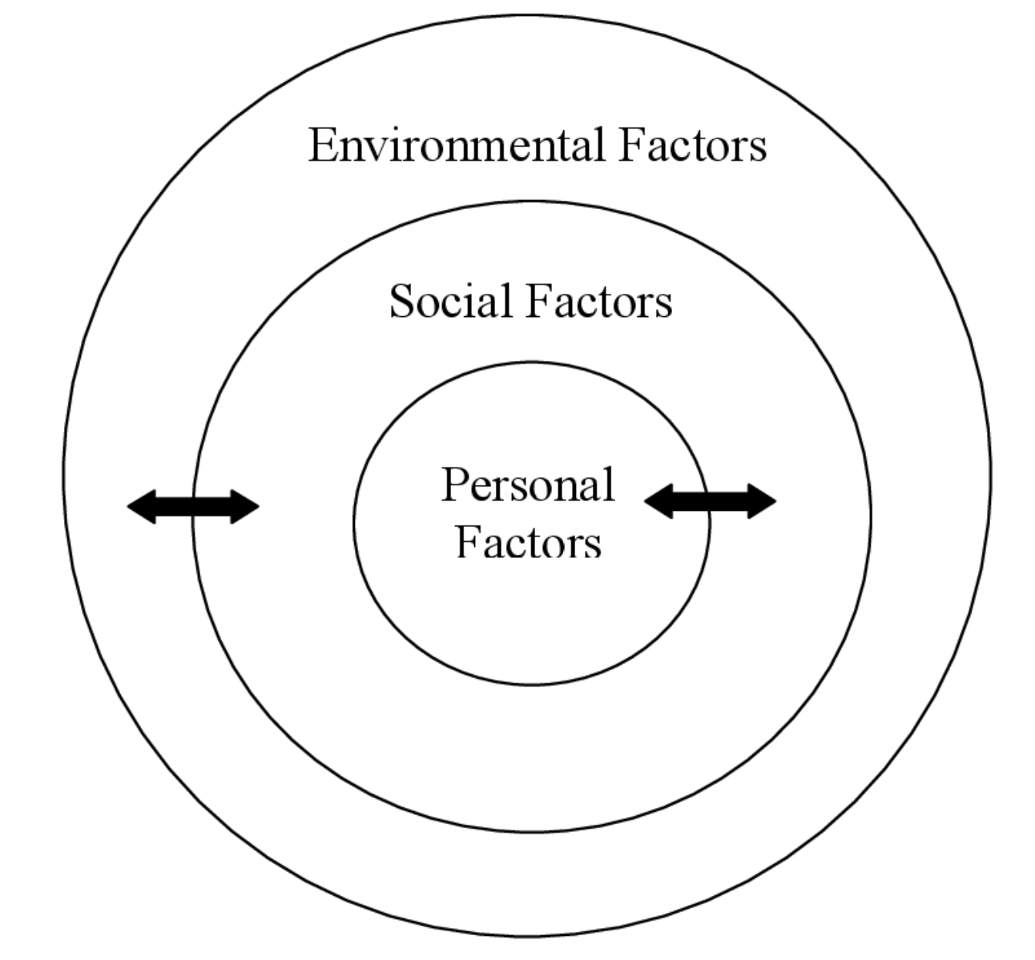
Results & Discussion
Impact of covid-19 on mental health
Environmental: financial insecurity, uncertainty about the future
Social: limited in-person interactions
Personal: disrupted routines, lack of physical activity
Notes:
Experienced personal, social and environmental stressors during COVID-19.
Impact on mental health:
Personal: disrupted routines, lack of physical activity
Social: limited in-person interactions
Environmental: financial insecurity, uncertainty about the future.
All of these factors are at interplay and influence mental health.

Slide 13
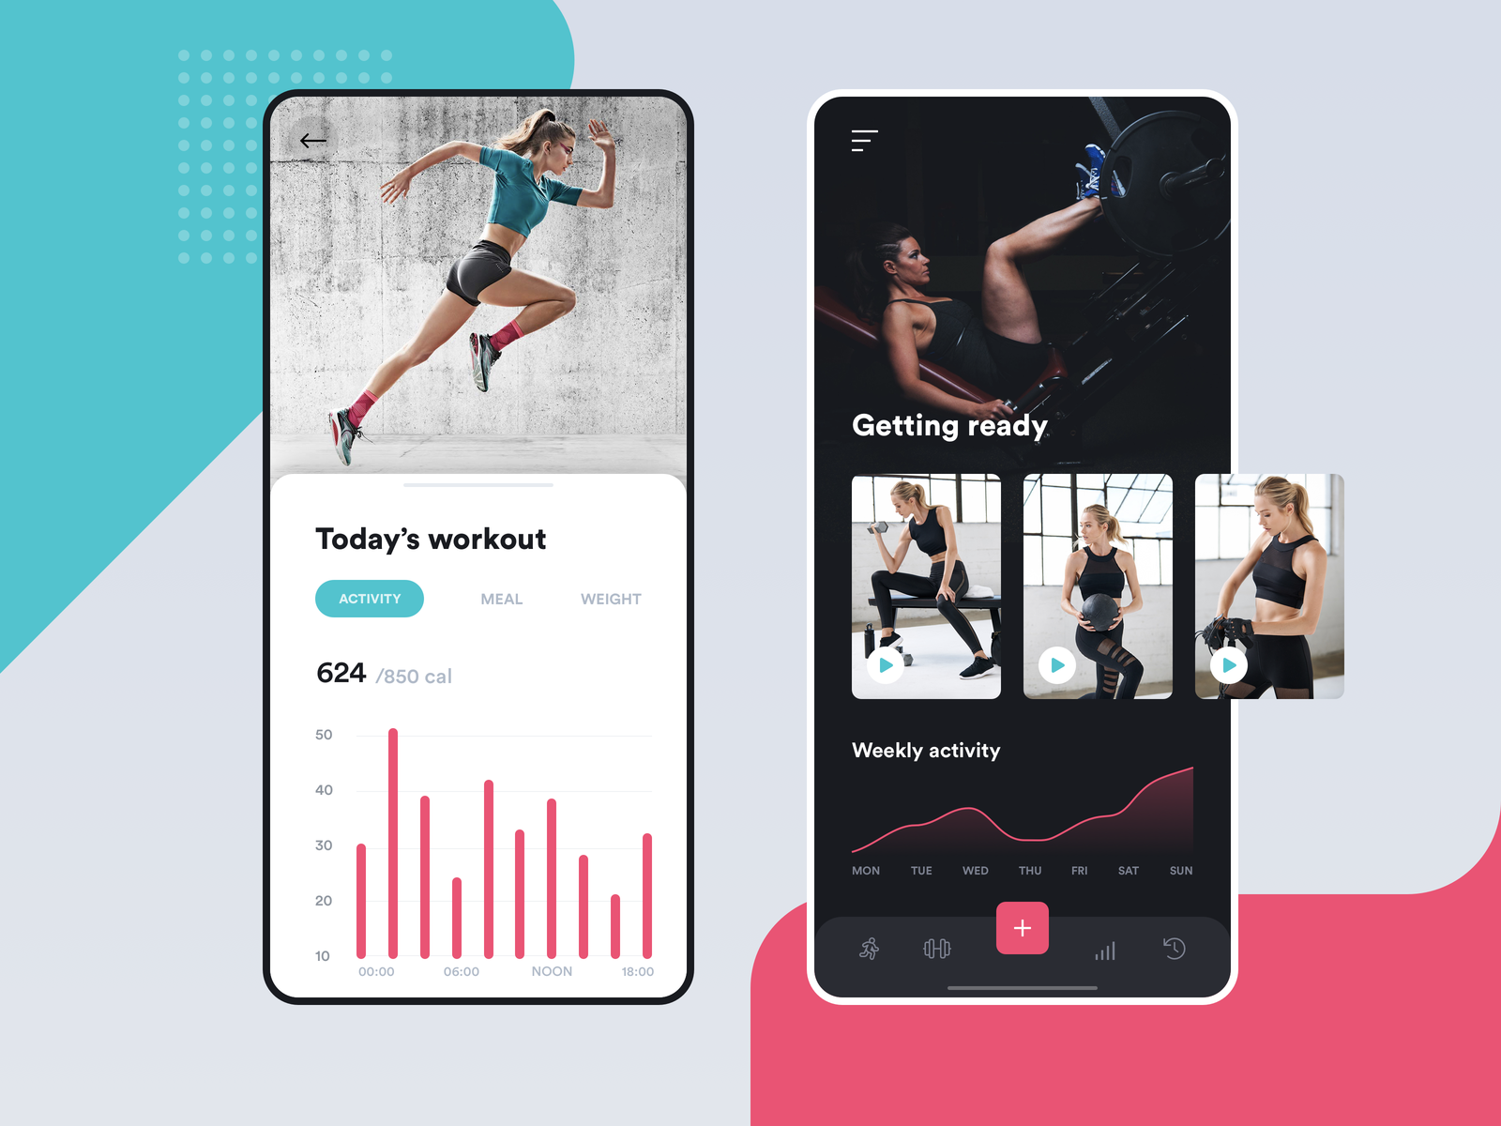

Results & Discussion
Coping strategies using technology
Notes:
Technology help:
Mobile apps: try new exercises
Video calls: connect with family and friends

Slide 14

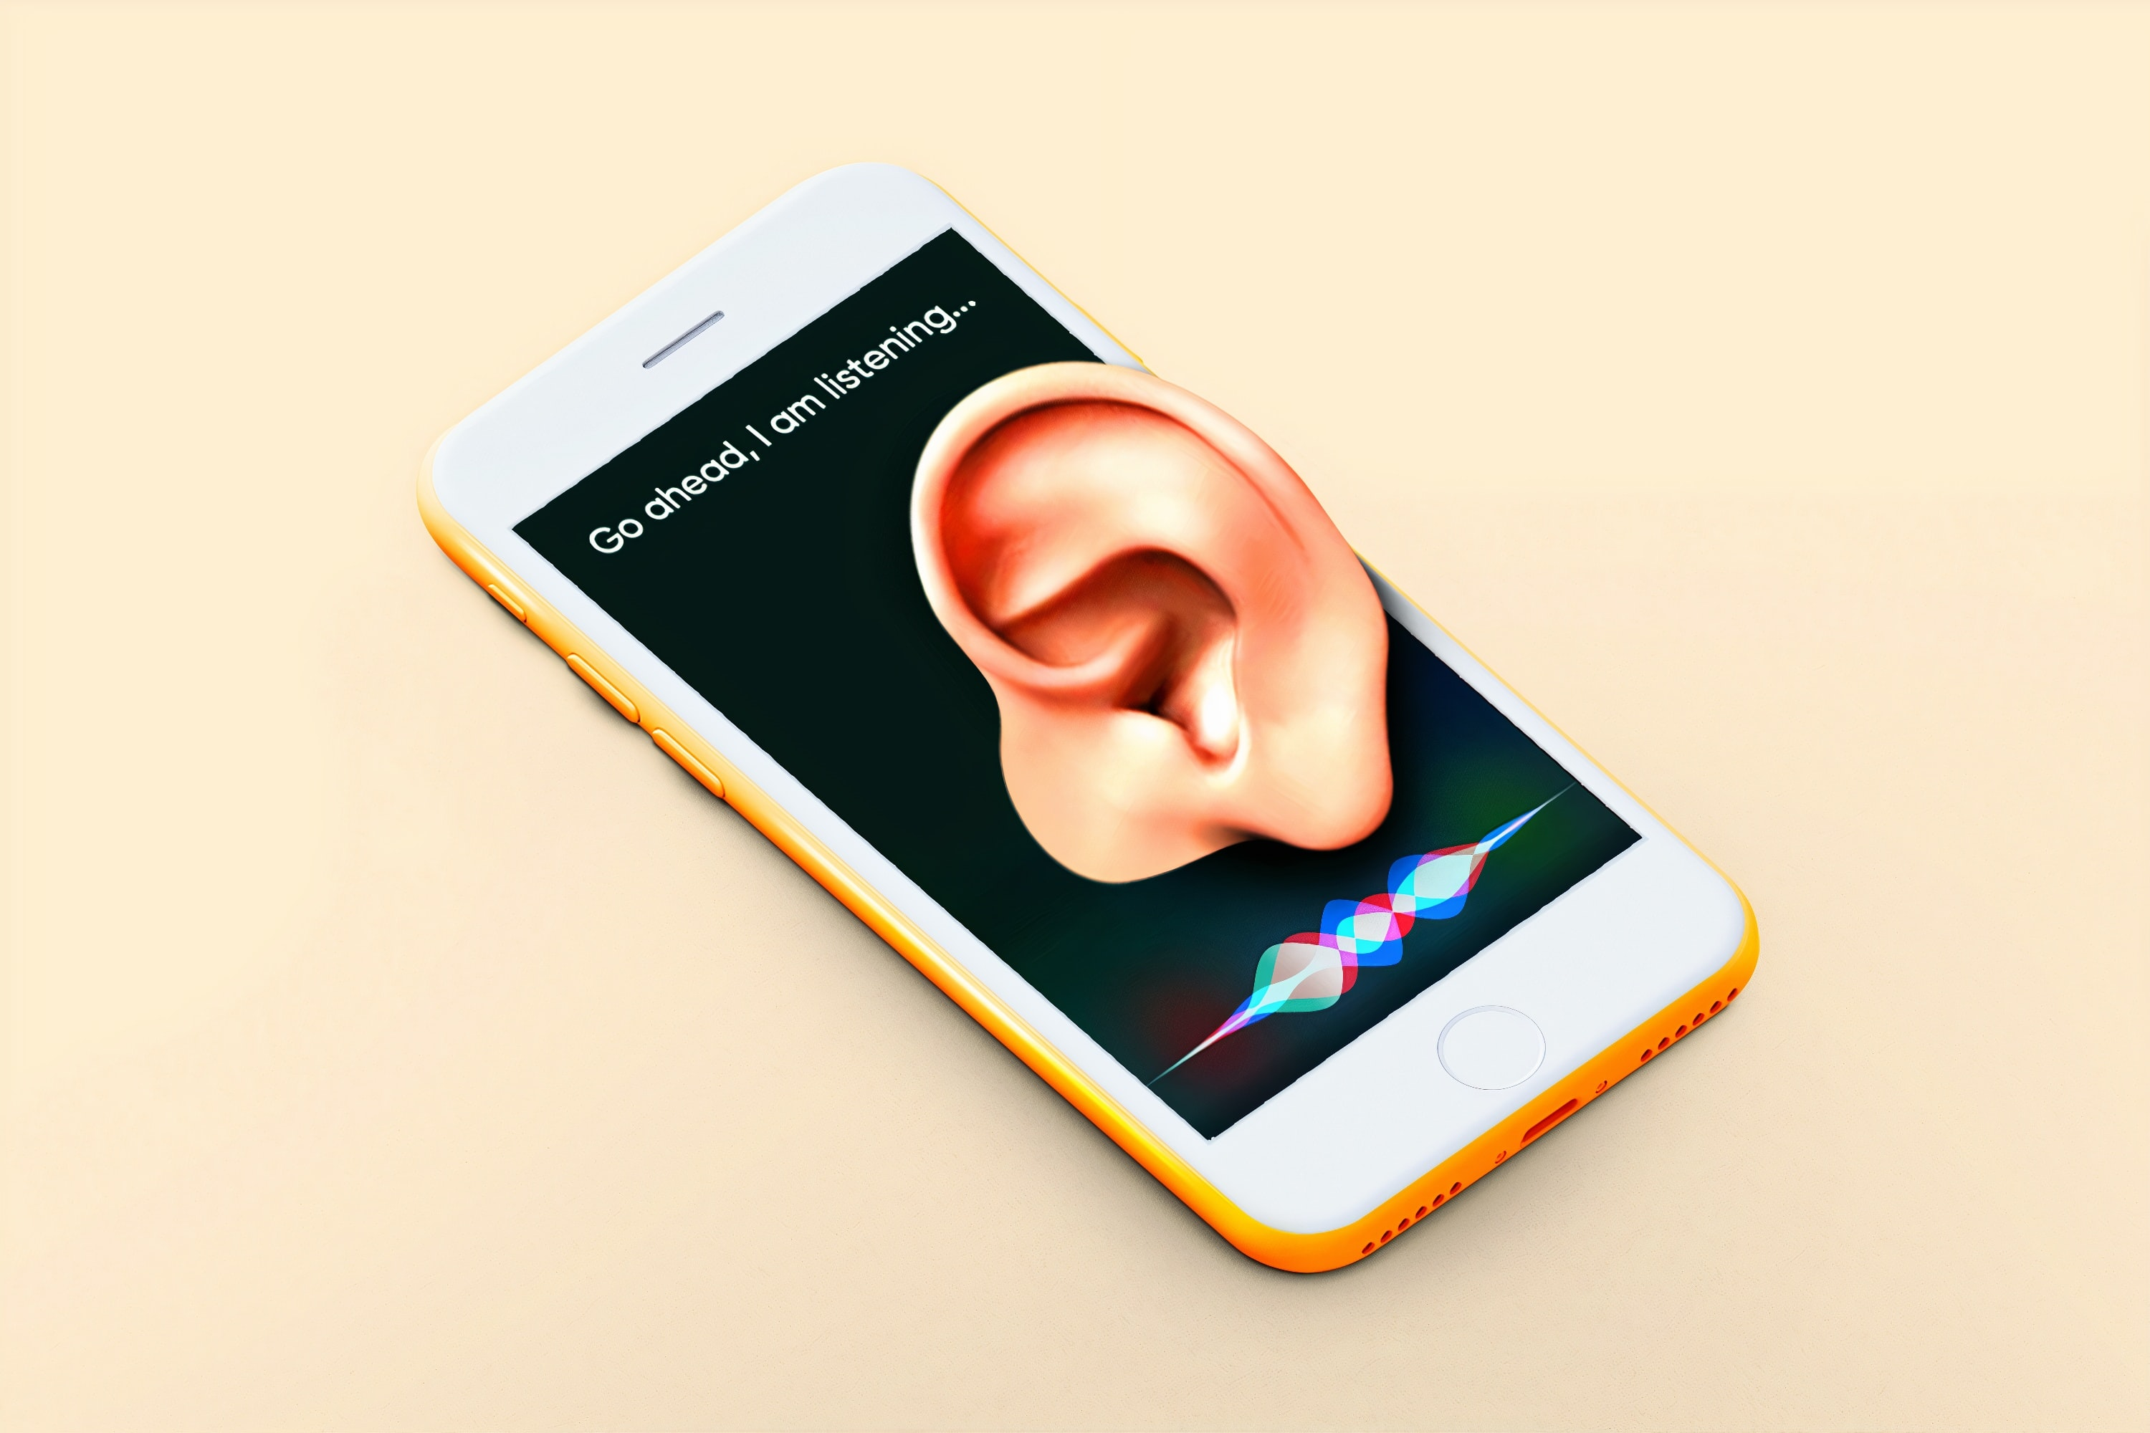
Results & Discussion
What is missing?
Notes:
What is missing:
Struggle to find the right technology (e.g. There are so many apps!) – some concerns about effectiveness and safety.
Virtual health assistant to help establish routine, perform mental health check-ins and reflection

Slide 15
Outline
Background
Methods
Results & Discussion
Conclusion
Notes:
Take home message: 3 things:
Impact on young adults
How tech can help
How can we improve policy
Contact details at the end.
Include strengths and limitations.
Comparison with the literature – background or discussion.
Next steps

Slide 16
Conclusion
Take home messages
Young adults experienced multiple health stressors during COVID-19.
Translational outcomes: Technologies can be part of the solutions.
Next steps:
- Better understand the mental health impact of COVID-19 on other population groups
- Leverage technologies to put mental health at the centre of post COVID recovery.
Twitter: @lytong22
E: huong.tong@sydney.edu.au
Notes:
Young adults experienced multiple health stressors during COVID-19
Translational outcomes: Tech can be a part of the solutions.
While current health practices have outlined several strategies to support mental health for young people (e.g. stay active, establish new routines), specific suggestions are lacking on how to implement those strategies. Perhaps this is where technologies can come in by providing specific recommendations and support. I am not saying technologies is the only solution, but it can provide some support to young adults.
As with any studies, our findings must be interpreted in light of its strengths & limitations: Semi-structured interviews allow us to gain deep insights on a sensitive topic like mental health. As our population was young adults, particularly university students, more research is needed to help us better understand the mental health impact of COVID_19 on other population groups.
Next steps – where do we go from here:
Research to Better understand the mental health impact of COVID_19 on other population groups
Public health policies can capitalise on community interest in mental health, and look for opportunities to leverage technologies to put mental health at the centre of post-covid world.
Thank you so much for listening to the presentation.
Contact details at the end.
Please feel free to reach out via twitter or email below.
Hope you enjoy the rest of the conference.

